Slide 1

SEIS 632-02 Data Analytics & Visualization
Career Pathway
Project By : Pragya Verma
Mugdha Dixit Kidist Wolde
Ramesh Babu Balaji

Slide 2
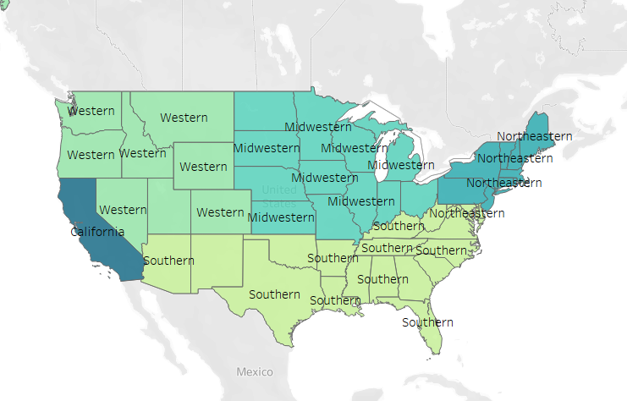
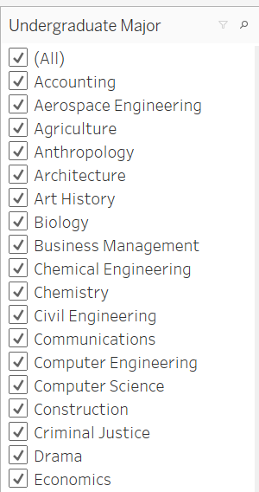
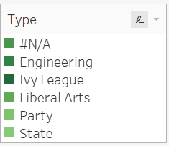
College Dataset
PayScale Inc, conducted a survey of 1.2 million people with only bachelor’s degrees over the course of a year, and based on that we were provided a dataset to work on our final project.
We explored the dataset and found insights based on the given attributes below.
The dataset consists of following attributes:
Starting median salary
Mid career median salary(salary after 10 years)
Mid career 10th, 25th, 75th and 90th percentile salary
The salaries are based on three parameters : College type, Region and Major.
As this is a survey dataset, we observed some missing values and outliers in our dataset, like:
Some colleges did not had the college type.
Salaries for some percentiles were missing.
We also observed few outliers which we kept untouched as suggested by our prof.
Also, there were few duplicate values which we removed successfully .
The question which we thought of addressing here with our project is how to select the best college so that one can make more earnings in the long run.

